Slide 1
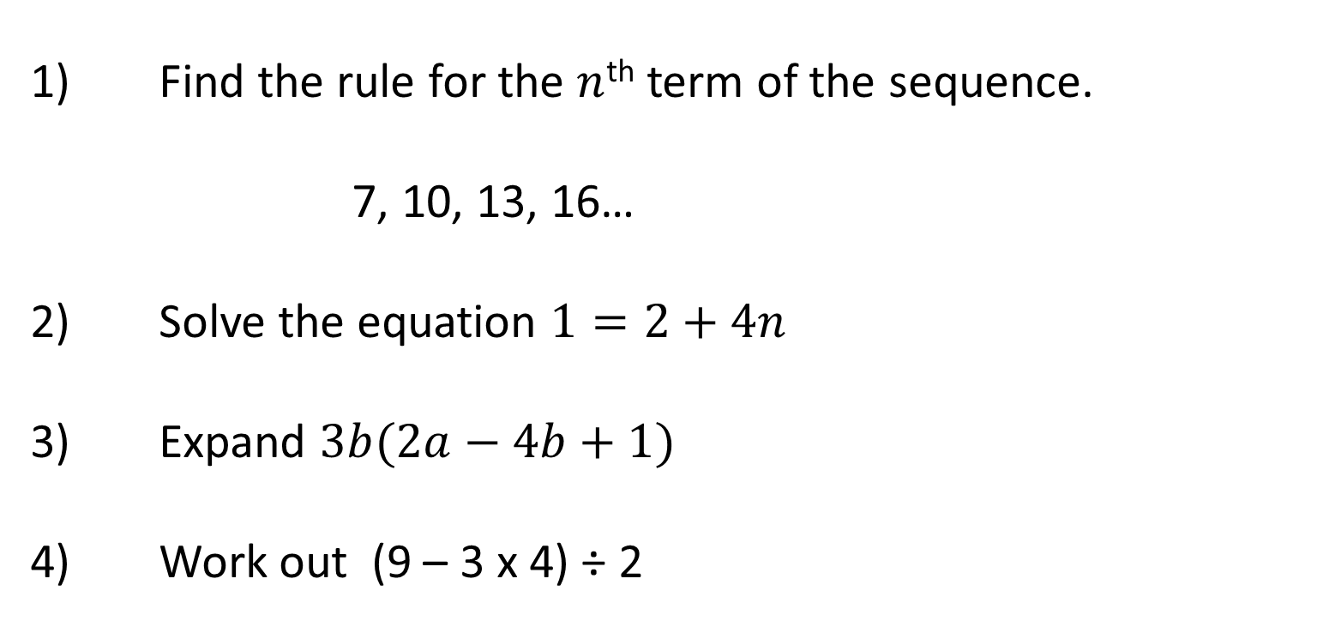
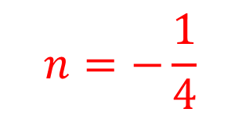
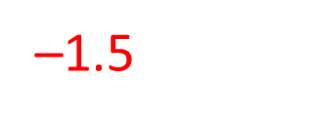
Y8 Spring| Week 6 | Day 1

Slide 2
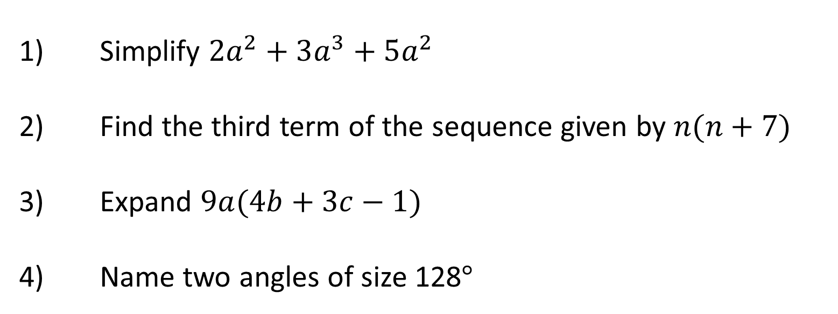
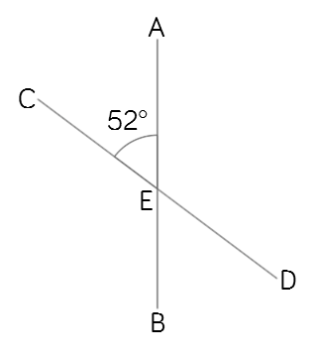
Y8 Spring| Week 6 | Day 2

Slide 3
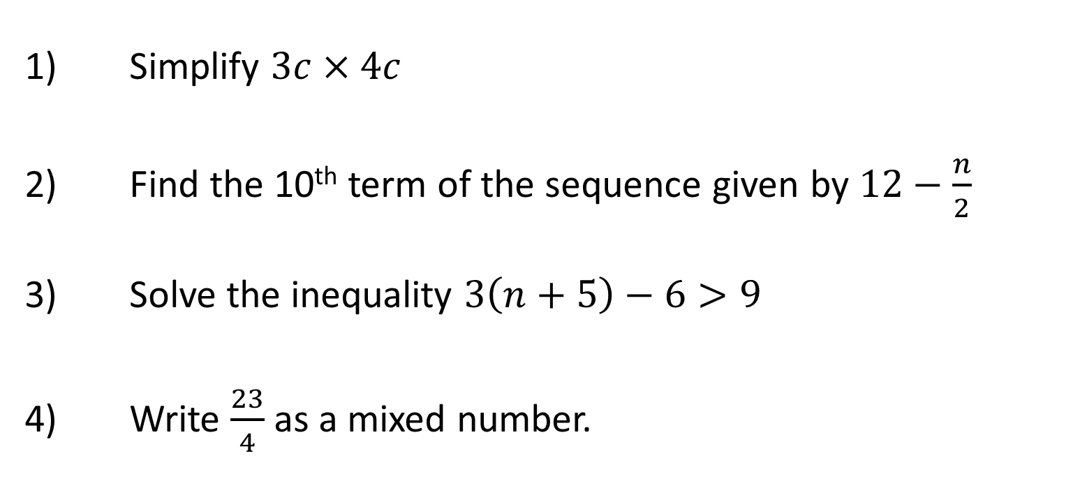
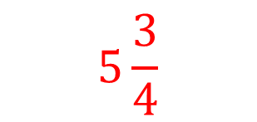
Y8 Spring| Week 6 | Day 3

Slide 4
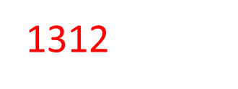
Y8 Spring| Week 6 | Day 4

Slide 5
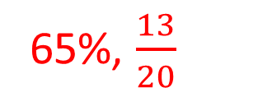
Y8 Spring| Week 6 | Day 5
65%, $\frac{13}{20}$

